Slide 1
Design a Classifier to Assess the Quality of Medicinal Plants Using Learning Algorithms By
Sayali Kapse
( Roll No:-23AI003)
Second Year, ME Artificial Intelligence and Data Science
Under the guidance of
Dr. M. A. Pradhan
Associate Professor
Computer Engineering Department
Academic Year 2024-25

Slide 2
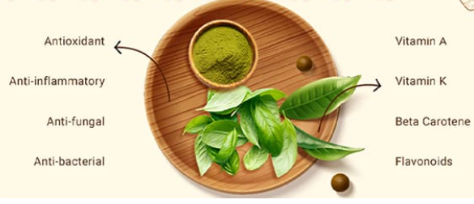
Index
INTRODUCTION
PURPOSE & MOTIVATION
PROBLEM STATEMENT
AIM & OBJECTIVES
SYSTEM ARCHITECTURE
METHODOLOGY
RESULTS & OUTPUT SCREENS
CONCLUSION
REFERENCES

Slide 3
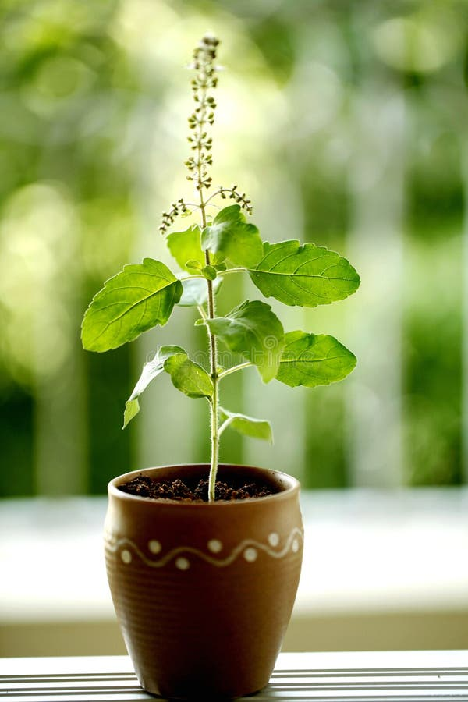
Introduction
Medicinal plants are very important in treating many health problems.
According to the World Health Organization, about 80% of people around the world use herbal medicines
for their basic health needs.
Tulsi (Holy Basil) is one of the most commonly used medicinal plants.
It helps with:
Reducing stress
Fighting infections
Improving immunity
Supports breathing and heart problems
To use these plants safely, we need to make sure they are healthy and of good quality.
But checking them manually takes time and can be wrong sometimes.
With the help of Artificial Intelligence (AI) and Machine Learning (ML),
we can build a classifier that can check the plant's quality quickly and correctly.
This project aims to build a classifier that looks at Tulsi leaf images and tells, if it is:
Healthy or Diseased along with name of disease
Lost medicinal properties
Recommendation measures

Slide 4
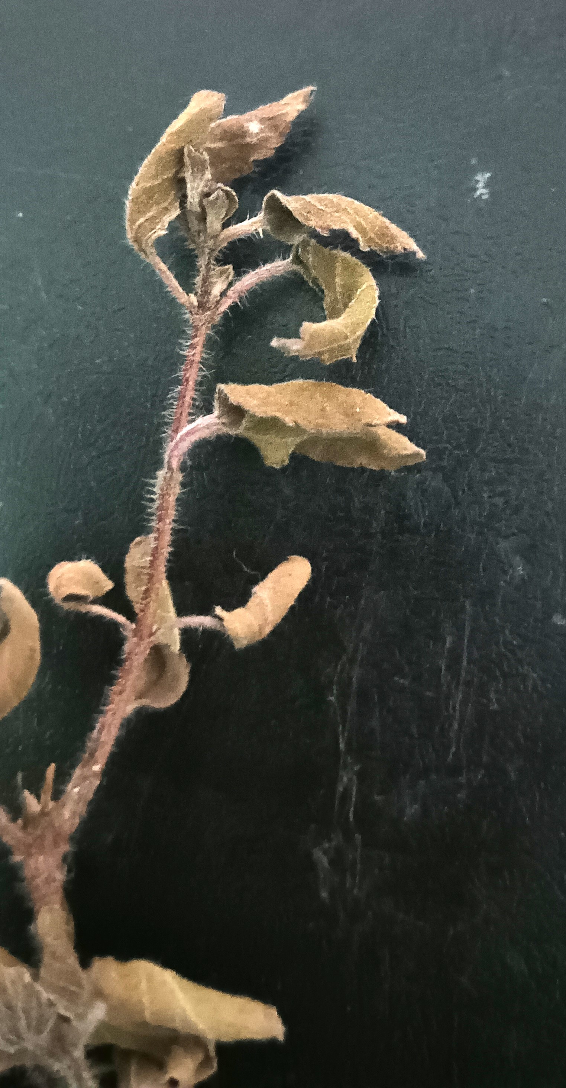
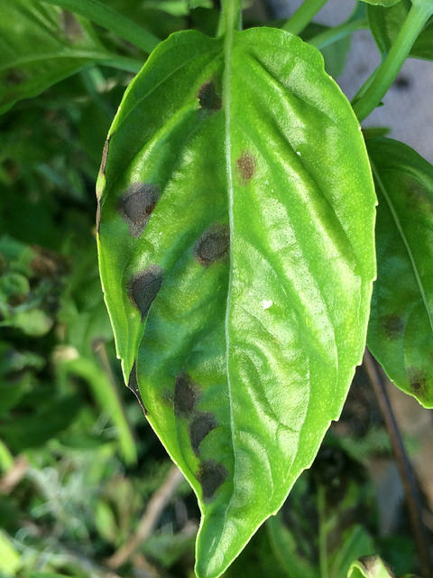
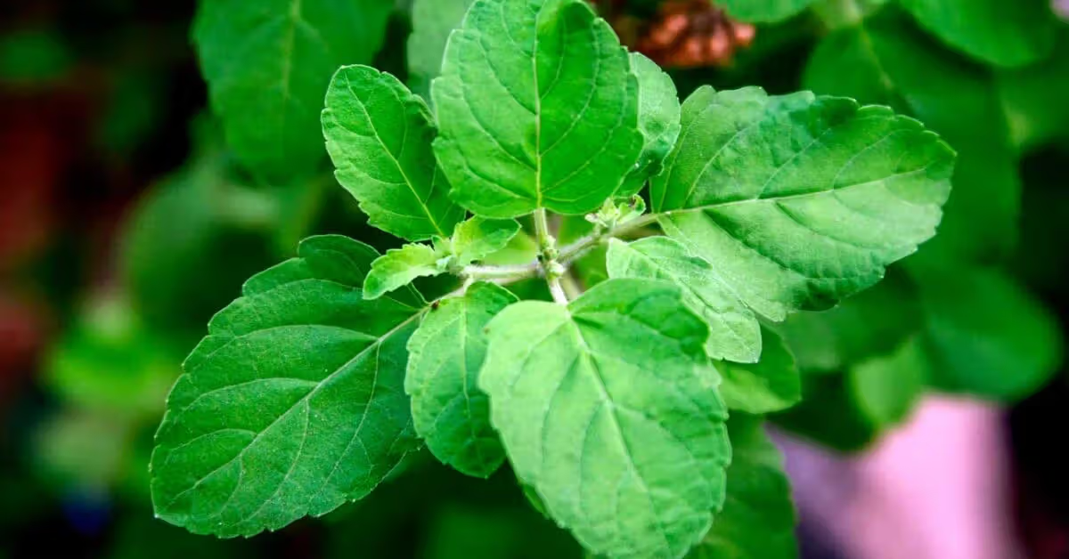
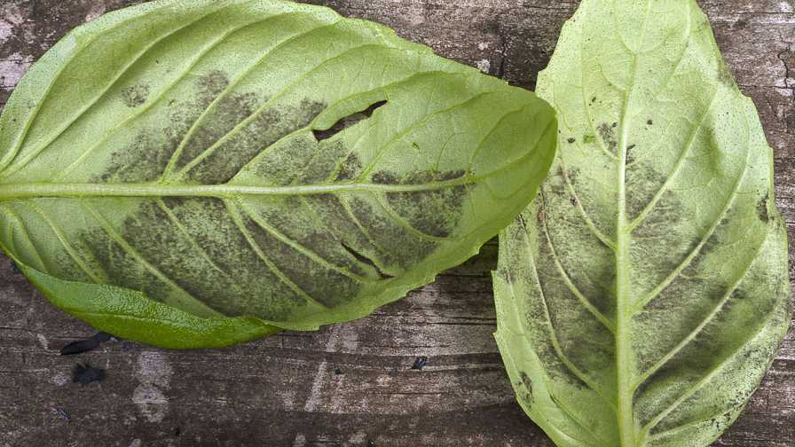
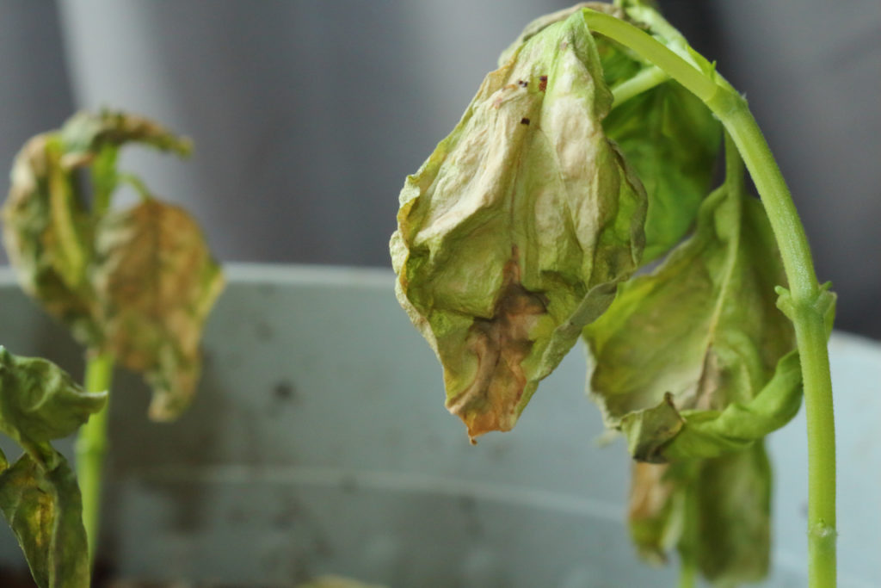
Introduction
Healthy
Disease Name | Downy Mildew | Fusarium Wilt | Gray Mold | Septoria Leaf Spot.
Image
Lost Properties | Reduced antibacterial and antiviral effectiveness Weakened ability to boost the immune system Loss of anti-inflammatory benefits Decrease in antioxidant content Reduced effectiveness in treating respiratory issues Lower ability to manage stress (adaptogenic property) Unpleasant taste and smell affecting medicinal use | Decreased overall vitality and nutrient content of the plant Reduced concentration of essential oils (e.g., eugenol) Weakened anti-fungal and anti-bacterial properties Loss of effectiveness in treating digestive issues Reduced stress-relief and calming effects Lowered efficiency in managing blood sugar levels Impaired ability to support liver and kidney function. | Decline in natural antimicrobial properties Loss of aromatic compounds and essential oils Reduced anti-inflammatory effects Weakened antioxidant activity Diminished respiratory support capabilities Lower effectiveness in relieving cold and cough symptoms Unusable for herbal tea’s or oil extraction due to spoilage and foul odor. | Reduced concentration of healing phytochemicals (like eugenol and ursolic acid) Weakened antibacterial and antiviral effects Decreased ability to treat skin infections and wounds Lower anti-inflammatory response Impaired support for digestive health Decline in antioxidant strength Leaves become unsuitable for medicinal use

Slide 5
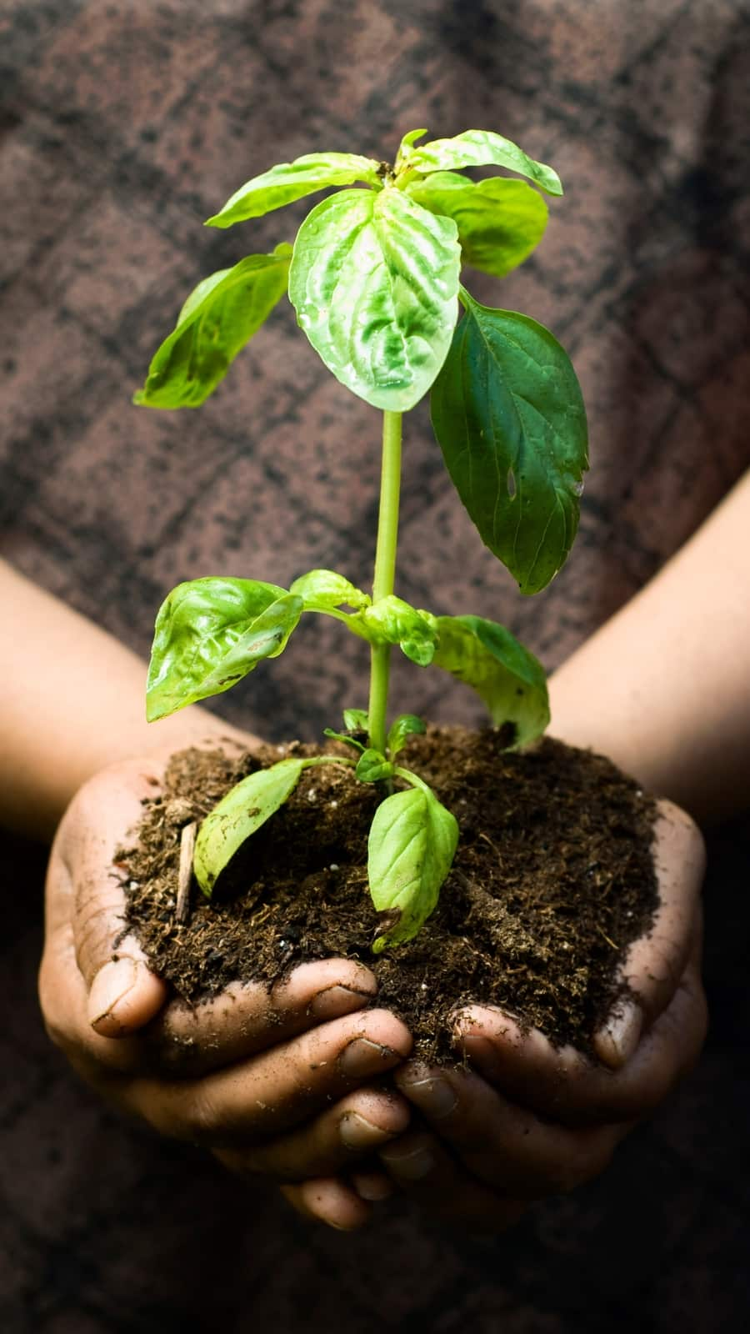
Purpose & Motivation
Medicinal plants like Tulsi are widely used in natural medicine for treating various health issues.
The effectiveness of these plants depends on their quality and health, which is often affected by diseases.
Manual quality checks are slow, subjective, and error-prone.
There is a need for a quick, reliable system to check the health of medicinal plants.

Slide 6
Problem Statement
“To design and develop a classifier using learning algorithms that can assess the quality of Tulsi leaves by identifying whether the plant is healthy or affected by disease.”

Slide 7
Aim and Objectives
Aim :
The aim of the project is designing a classifier to assess the quality of medicinal plant using learning algorithms.
Objectives :
Extensive study of state of art literature on quality assessment of medicinal plant.
To identify and gather data relevant to medicinal plant quality
To perform data pre-processing.
Design classifiers using learning algorithms.
To select the best classifier and optimize it.
To validate the efficacy of proposed classifier.

Slide 8
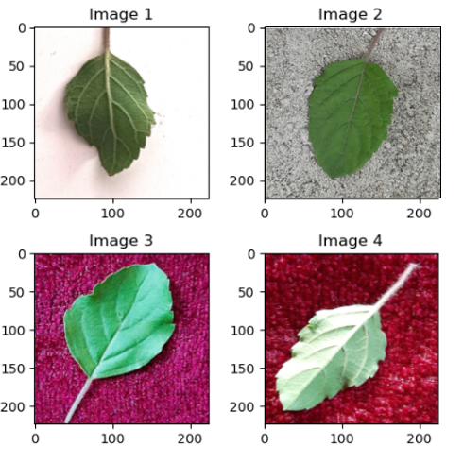
Dataset
For our classifier, primarily focusing on Basil, Leaf samples were collected and verified by plant experts to ensure high data accuracy and reliability.
We have prepared dataset of basil image 666 in total distributed into labelled sets based on disease category with augmentation resulting in 2986 images.
This dataset has 5 subfolders which contain images of healthy Basil leaves and other 4 folders are diseased basil leaves namely ‘Downy Mildew’, ‘Fusarium Wilt’, ‘Gray Mold’, ’Septoria Leaf Spot’

Slide 9
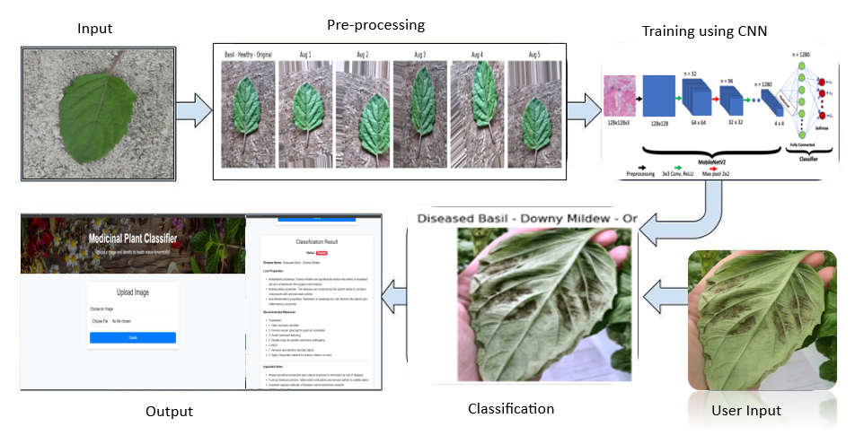
System Architecture

Slide 10
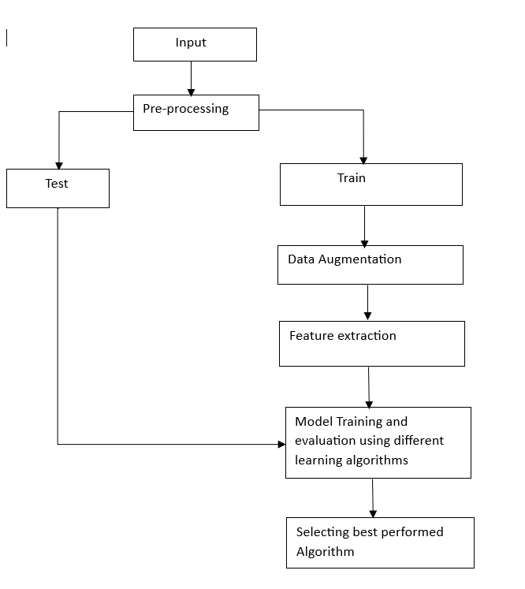
Methodology
In the proposed system, we used input as our prepared dataset.
Then applied preprocessing techniques on the dataset, like:
i. Image Standardization (resizing to 224×224)
ii. Contrast Enhancement
iii. White Balance Correction (to normalize color presentation)
The dataset was then split into training and testing sets.
Data augmentation techniques were applied to the training set to increase diversity and reduce overfitting.
The pre-processed and augmented dataset was then passed as input to multiple machine learning algorithms.
Each algorithm was evaluated using the confusion matrix and validation accuracy on the test data.
The model achieving the highest accuracy (i.e., CNN with 89.22%) was selected as the final model for our project.
Notes:
Feature extraction is done using ‘skimage.feature’ library mainly focusing on color, texture, and shape. (using: using GLCM (Gray-Level Co-occurrence Matrix).)

Slide 11
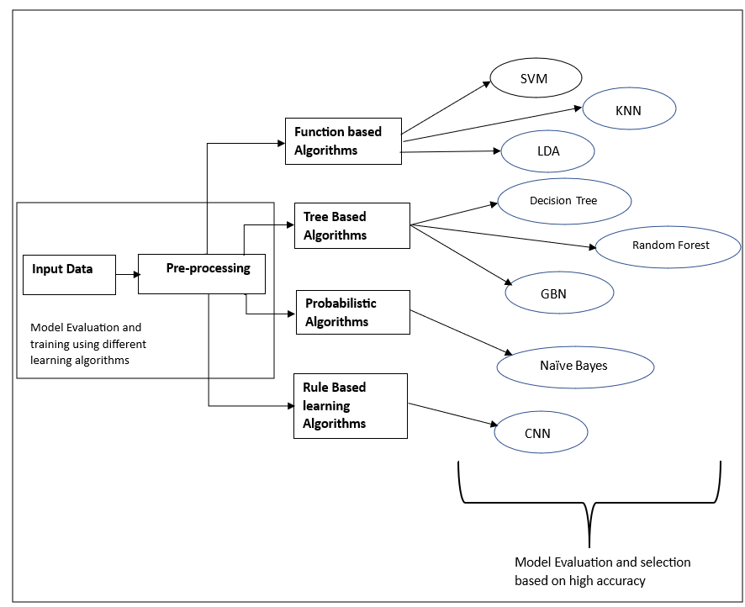
Methodology
SVM – Support vector Machine, KNN – K-Nearest Neighbour, LDA – Linear Discriminant Analysis, GBN – Gradient Boosting, CNN – Convolutional Neural Network

Slide 12
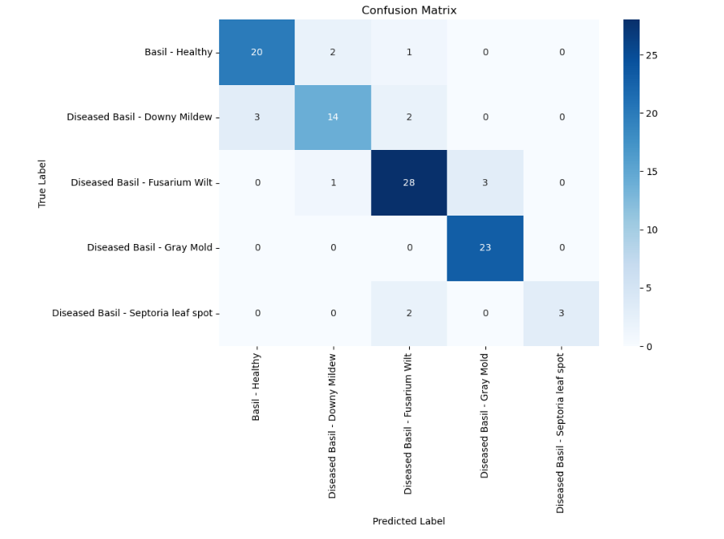
Results
Learning Algorithms Accuracy
Function based Algorithms | Accuracy
SVM | 85.89
KNN | 73.09
LDA | 62.44
Tree Based Algorithms | Accuracy
Decision tree | 62.2
Random Forest | 82.66
GBN | 77.87
Probabilistic Algorithms | Accuracy
Gaussian Naive Bayes | 56.1
Rule Based learning Algorithms | Accuracy
CNN | 89.22
Figure: Confusion Matrix of CNN

Slide 13
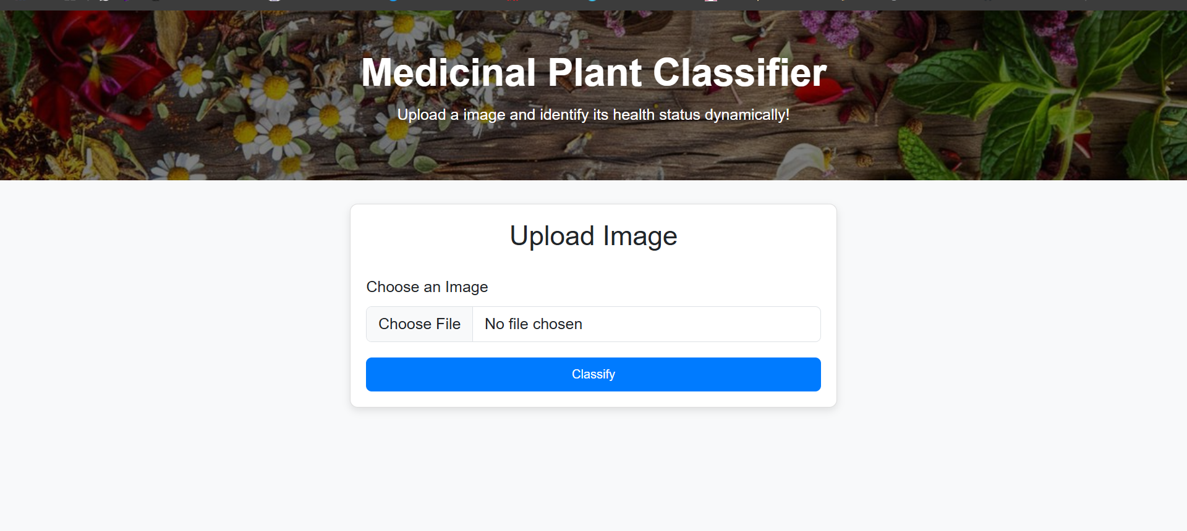
Output screens

Slide 14
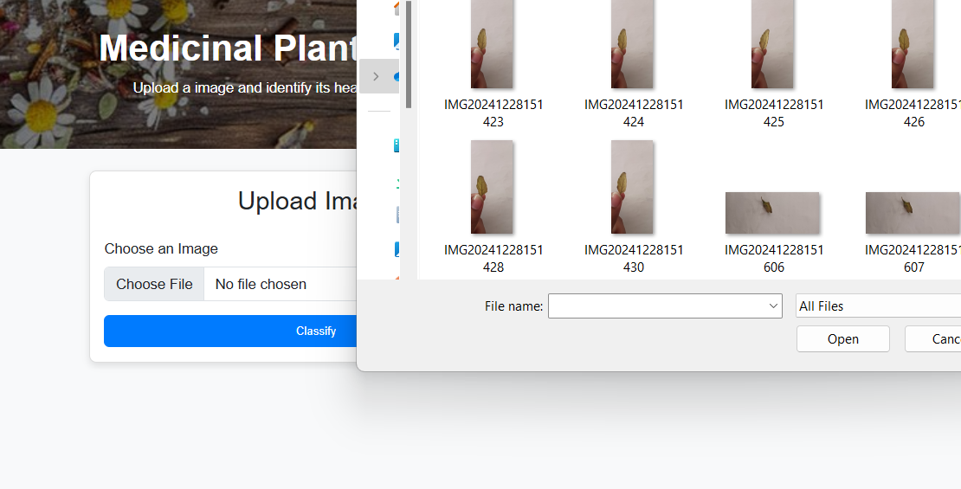
Output screens

Slide 15
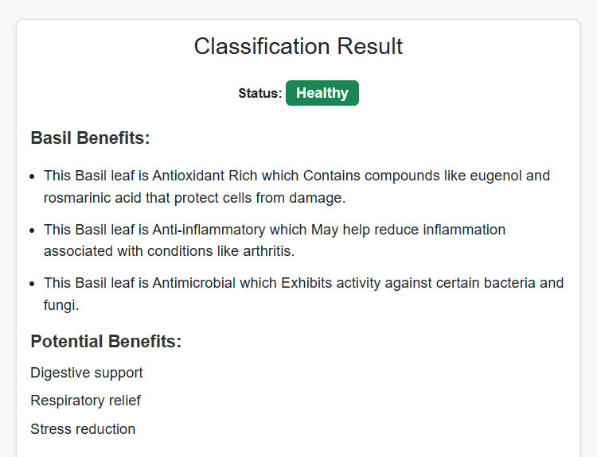
Output screens
If Basil is Healthy below results :

Slide 16
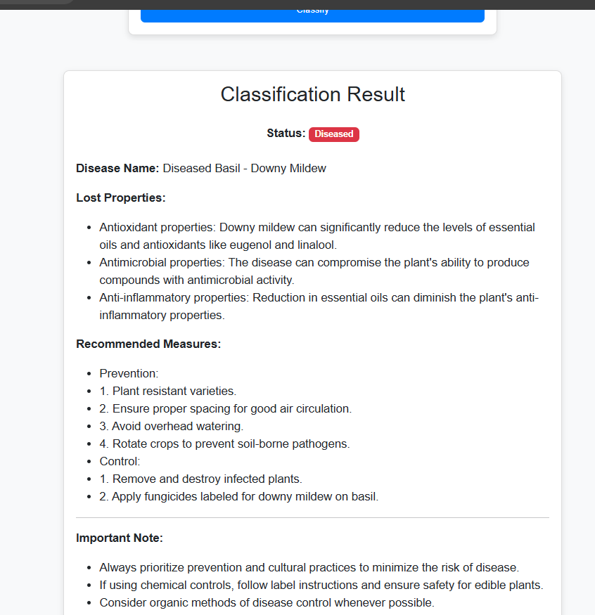
Output screens
If disease is Downey Mildew, Below Prediction

Slide 17
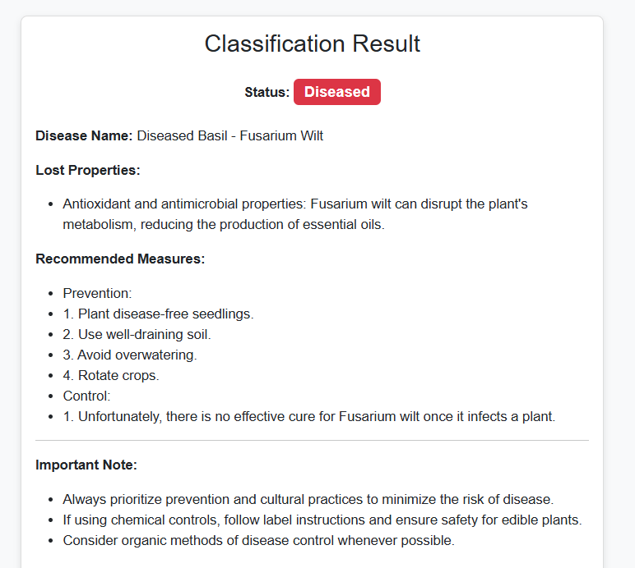
Output screens
If disease is fusarium wilt, below results :

Slide 18
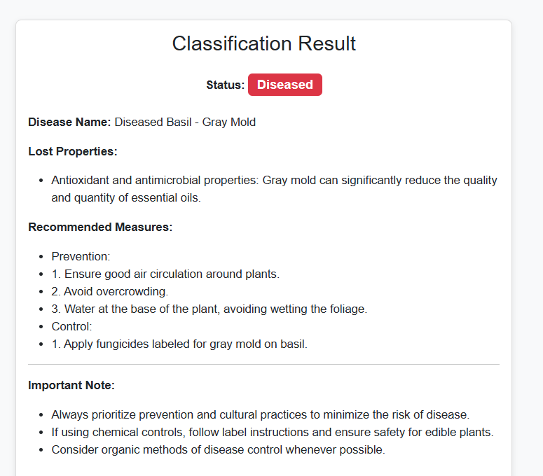
Output screens
If disease is Grey Mold :

Slide 19
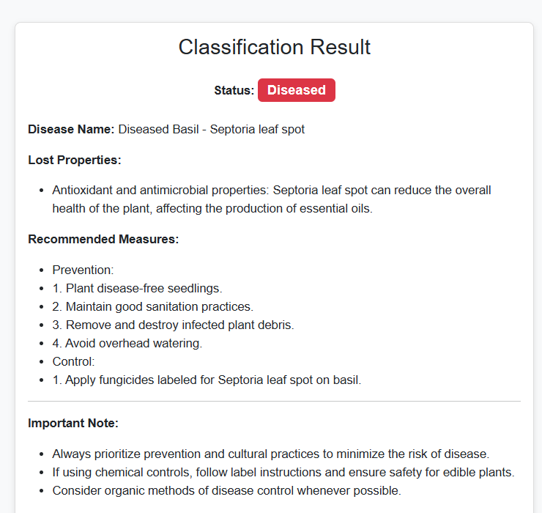
Output screens
If disease is Septoria leaf spot :

Slide 20
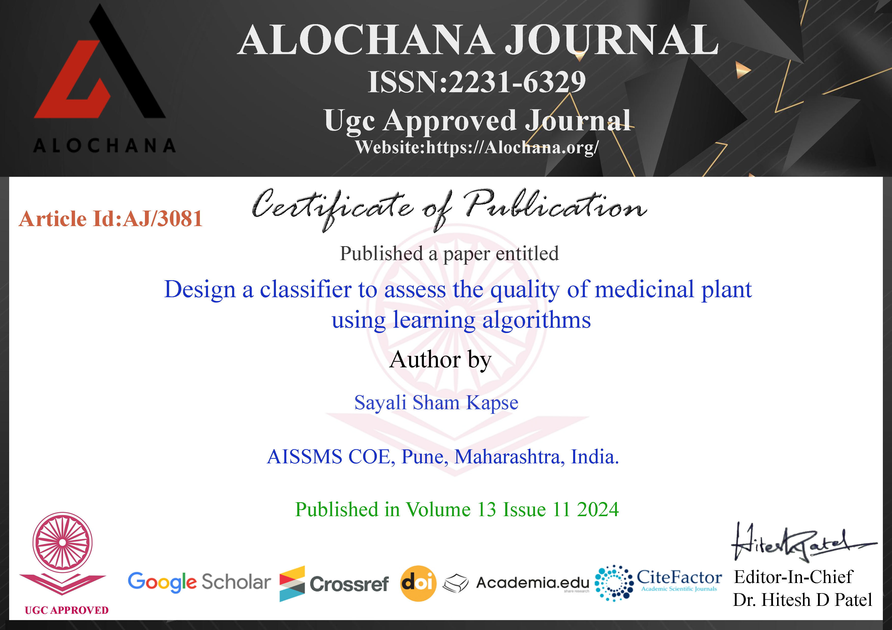
Dissertation I
Stage one published paper : https://alochana.org/volume-13-issue-11-2024/

Slide 21
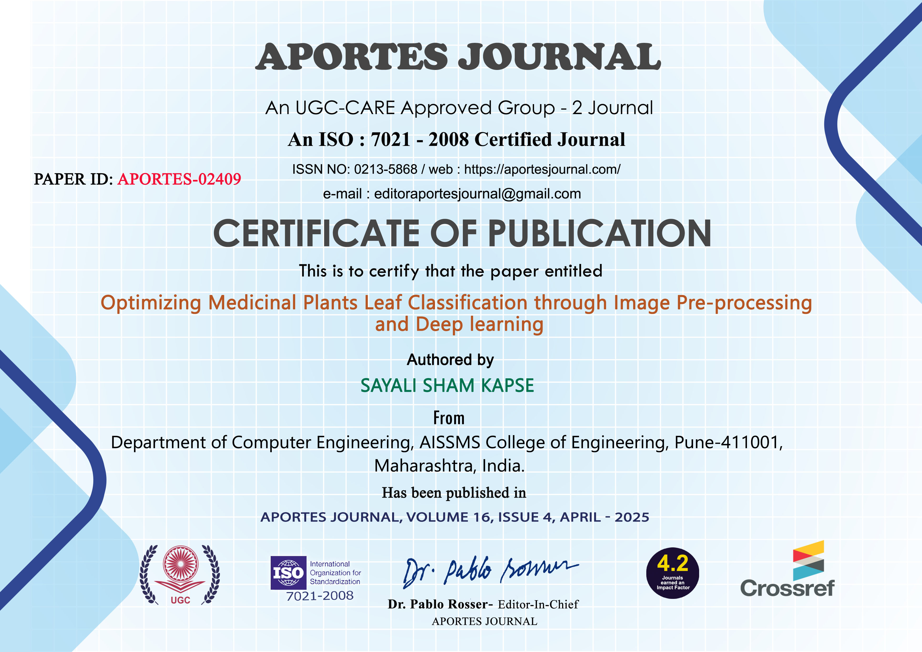
Dissertation-II
Paper published link: https://aportesjournal.com/volume-16-issue-4-2025/

Slide 22
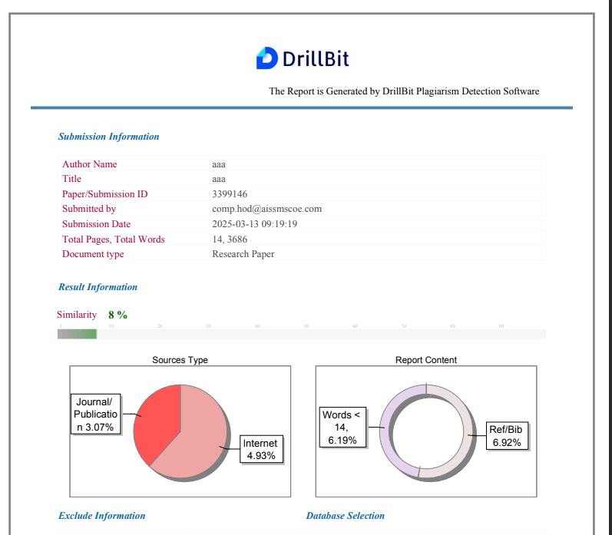
Dissertation II

Slide 23
Conclusion
We performed extensive study of state of art literature on quality assessment of medicinal plant.
We have identified and gathered data relevant to medicinal plant quality.
We have performed data pre-processing techniques like Image Standardization, Contrast Enhancement and White Balance Correction on our dataset.
We have designed classifier using various learning algorithms like function based, tree based, Rule based learning algorithms.
We have evaluated performance of each algorithm and selected the best algorithm for our classifier.

Slide 24
References
1. Sathiya, V. ., Josephine, M. S. ., & Jeyabalaraja, V. . (2023). Plant Disease Classification of Basil and Mint Leaves using Convolutional Neural Networks. International Journal of Intelligent Systems and Applications in Engineering, 11(2), 153–163.
2. Mane, Deepak & Deore, Mahendra & Ashtagi, Rashmi & Shinde, Sandip & Gurav, Yogesh. (2023). Basil plant leaf disease detection using amalgam based deep learning models. Journal of Autonomous Intelligence. 7. 10.32629/jai.v7i1.1002.
3. P. K. Sharma, “Medicinal Plant Identification by Leaf Structure Using Ensemble Methods on Deep Learning Algorithms”, IJRAMT, vol. 5, no. 9, pp. 51–53, Sep. 2024, Accessed: Apr. 08, 2025.
4. Sinha, S., Rana, T., and Roy, R., “A novel approach to navigate the taxonomic hierarchy to address the Open-World Scenarios in Medicinal Plant Classification”, <i>arXiv e-prints</i>, Art. no. arXiv:2502.17289, 2025. doi:10.48550/arXiv.2502.17289.
5. Mane, Deepak & Deore, Mahendra & Ashtagi, Rashmi & Shinde, Sandip & Gurav, Yogesh. (2023). Basil plant leaf disease detection using amalgam based deep learning models. Journal of Autonomous Intelligence. 7. 10.32629/jai.v7i1.1002.
6. Ahmed, M., & Gupta, R. (2022). Transfer learning for medicinal plant quality assessment. Plant Sciences and AI Journal, 11(4), 140-151. https://doi.org/10.1016/j.psai.2022.140151
7. Karthika, K., Fazith, A. J., & Dhinesh, A. (2020). Medicinal plant identification using CNN. Plant Sciences and AI Journal, 20(3), 176-184. https://doi.org/10.1016/j.psai.2020.112343
8. Lee, S., Park, Y., & Kim, H. (2021). Mobile CNN for plant disease detection. Computer Vision in Agriculture, 14(3), 190-200. https://doi.org/10.1016/j.cvag.2021.112301
9. Kumar, M., & Sharma, A. (2021). Comparative analysis of plant classification techniques. International Journal of Computer Vision in Agriculture, 6(1), 112-120. https://doi.org/10.1016/j.cvag.2021.113021
10. Mishra, R., & Patel, D. (2021). AI techniques for medicinal plant identification. Computers and Electronics in Agriculture, 13(4), 233-245. https://doi.org/10.1016/j.compag.2021.102311
11. Zhang, X., Luo, J., & Zhou, P. (2019). Soil and climate factors in plant quality evaluation. Environmental Agriculture Journal, 15(2), 221-234. https://doi.org/10.1016/j.envag.2019.108765

Slide 25





Thank You…!
Get in Touch
AISSMS COE Kennedy Road, Near R.T.O., Pune - 411 001, Maharashtra (INDIA)
www.aissmscoe.com
/ AISSMS_COE

